Slide 1
Employee Data Analysis using Excel
STUDENT NAME: JAYASHREE R
REGISTER NO: 073111558D707D5A41C41951C8DBD08A
COLLEGE REGISTER NO: 122201823
DEPARTMENT: B.COM [CORPORATE SECRETARYSHIP]
COLLEGE :MEENAKSHI COLLEGE FOR WOMEN

Slide 2
PROJECT TITLE
Employee performance of: employee status, gender , current employee rating and dob.

Slide 3


AGENDA
Dataset Description
Modelling Project Overview
End Approach
Results and Discussion
Conclusion
Users
3/21/2024 Annual Review

Slide 4

PROBLEM STATEMENT
In order to improve organizational effectiveness and address potential biases, our company needs to analyzes employee performance data. Specifically we aim to understand how different factors such as employee status (eg) full time, part time

Slide 5

PROJECT OVERVIEW
To give you a comprehensive overview of these terms, let's break them down one by one:1. "Employee: This refers to an individual who is hired to perform specific tasks and duties for an organization or business. Employees typically work under a contract or agreement and are paid for their services. The term "employee" encompasses a wide range of roles and job titles, from entry-level positions to executive roles. 2. *Performance Employee Status": This likely refers to an employee's cure standing or assessment within a company based on their performance.

Slide 6

WHO ARE THE END USERS?
human resources managers
organisational leaders
performance analysts
department heads and supervisors diversity and inclusion officers

Slide 7

OUR SOLUTION AND ITS VALUE PROPOSITION
filtering -remove values
pivot tables - summary of employee data base
bar diagram - final report

Slide 8
DATASET DESCRIPTION
EMPLOYEE DATASET –NAN MUDHALVAN PORTAL9 FEATURES IN TOTAL3 FEATURES BEING USED FOR ANALYSIS EMPLOYEE ID – ALPHABETICAL (TEXT) NAME –ALPHABETICAL(TEXT) GENDER-ALPHABETICAL (TEXT) SALARY –NUMERICAL STARTDATE-ALPHANUMERIC(TEXT) FTE- NUMERICALEMPLOYEE TYPE- ALPHABETICAL (TEXT)EMPLOYEE TYPE-
ALPHABETICAL (TEXT)EMPLOYEE LOCATION-ALPHABETICAL (TEXT) .

Slide 9

THE "WOW" IN OUR SOLUTION
Effective data visualization makes it
easier to present complex data in an engaging data and understandable way.
Well-presented data can have a significant impact on decision - makers to drive change and innovation
3/21/2024 Annual Review
9

Slide 10
MODELLING
Step 1: download the employee dataset in naan
mudhalavan portal and open the excel .
step 2 : select the data and click on the filter
option
step 3 : filter ftp in asscending order ( a to z ) .
step 4 : select the entire data and click on insert
and click on insert and click on pivot table to
create pivot table .
10

Slide 11
step 5 : drag the needed data and create a pivot
table
step 6 : select the pivot table , click on insert –
choose the type of charts according to one’s
requirements . type of chart used in this analysis is
bar diagram .
step 7 : the table and chart is being created ,
which help in better understanding and
interpretation of data.

Slide 12
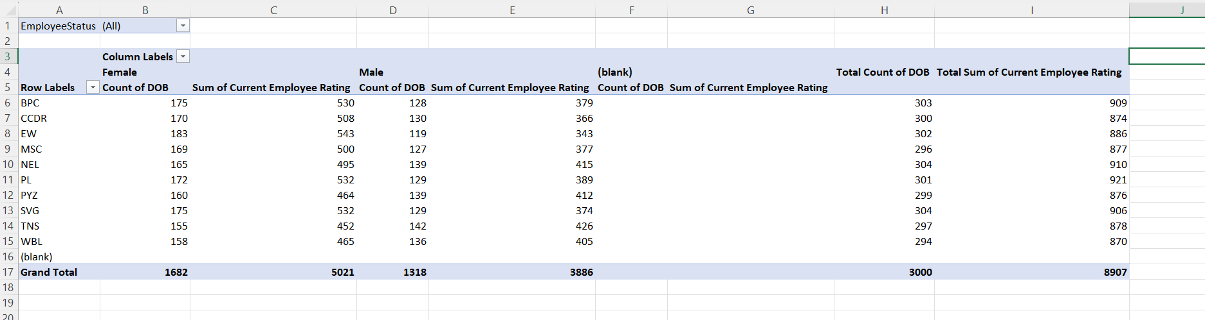
RESULTS
1.TABLE

Slide 13
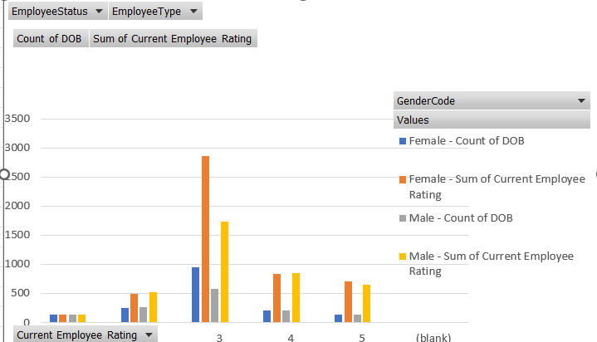
RESULTS
2.BAR DIAGRAM

Slide 14
conclusion
To conclude on employee performance based on factors like employee status, gender, current employee rating, and date of birth (DOB), Here's a general approach to drawing a conclusion:
*Employee Status (e.g., Full-time, Part-time, Contract):* -
*Observation:* Employees' performance can vary depending on their employment status. Full-time employees might have more stable performance due to job security and benefits, while part-time or contract employees might show varying performance based on short-term goals or projects.

Slide 15
*Gender:* - *Observation:* Gender might influence performance due to a variety of factors, including workplace dynamics, equality of opportunity, and cultural expectations. - *Conclusion:* If a significant difference in performance ratings is found between genders, it could indicate underlying biases or disparities in job roles, opportunities, or support.
*Current Employee Rating:* - *Observation:* Current employee ratings are a direct indicator of performance. Higher ratings suggest better performance, while lower ratings might indicate areas for improvement or a need for additional support. - *Conclusion:* Employees with higher ratings consistently demonstrate strong performance.

